Slide 1
C programming language:
C is a widely used and powerful programming language known for its efficiency and control.
. allows developers to write low-level code and has a structured programming approach. It is compiled, runs close to the hardware, and has an extensive library support. C is suitable for various applications, from small utilities to large-scale projects.
.In computer programming, C is a general-purpose programming language that was originally developed in the early 1970s by Dennis Ritchie at Bell Labs. It is a high-level language that provides low-level access to the computer's memory and supports structured programming.

Slide 2
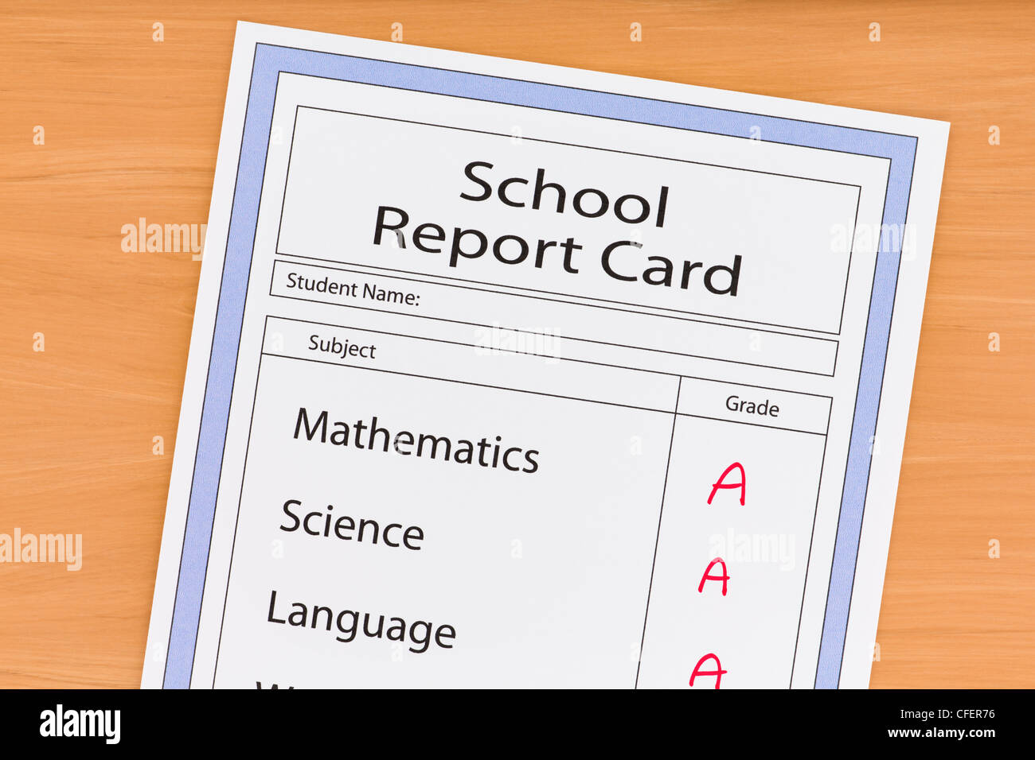
STUDENT REPORT CARD

Slide 3
Student report cards are commonly used in educational institutions to assess and communicate a student's academic performance and progress. Here are a few reasons why student report cards are used:
1. Evaluation of Performance: Report cards provide a comprehensive evaluation of a student's academic performance. They showcase the grades or scores achieved in various subjects, allowing teachers, parents, and students themselves to gauge their level of achievement.
2. Progress Tracking: Report cards help track a student's progress over a specific period, such as a semester or academic year. By comparing report cards from different periods, educators and parents can identify patterns, improvements, or areas where additional support may be require
3. Communication with Parents/Guardians: Report cards serve as a means of communication between teachers and parents/guardians. They provide a summary of a student's academic strengths and weaknesses, enabling parents to understand their child's progress and work together with teachers to support their learning.

Slide 4
4. Feedback and Motivation: Report cards often include personalized comments or feedback from teachers regarding a student's performance, behavior, or areas for improvement. This feedback can be valuable in providing guidance and motivation to students to enhance their learning experience.
5. Record Keeping: Student report cards are essential for maintaining a record of a student's academic history. They can be used for various purposes, including college applications, scholarships, and future academic or career opportunities.
6. Accountability: Report cards create a sense of accountability for students, as they are aware that their performance will be evaluated and communicated through these reports. This can motivate students to take their studies seriously and strive for better academic outcomes.
ABSTRACT
This report card presents a comprehensive assessment of the academic performance and overall development of a student during a specific period of evaluation. The report highlights key aspects of the student's progress, including their grades, attendance, and remarks from teachers. It serves as a snapshot of the student's achievements and areas for improvement, offering valuable insights to parents, teachers, and the student themselves. The report card acts as a communication tool, facilitating a constructive dialogue between stakeholders to support the student's growth and development.

Slide 5
ANALYSIS
1. Overall Performance: The report card reflects the student's academic performance and progress across various subjects. It provides an overview of their achievements and areas that may require improvement.
2. Grades: Assessing the grades for each subject gives an understanding of the student's performance in specific areas. Higher grades indicate proficiency and a good understanding of the subject matter, while lower grades may highlight areas that need attention.
3. Subject Strengths: Look for subjects where the student consistently received high grades. These areas indicate the student's strengths and aptitude.

Slide 6
4. Areas for Improvement: Identify subjects where the student received lower grades or inconsistent performance. These areas may require additional attention, focused studying, or extra support to enhance the student's understanding and performance.
5. Progress and Trends: Analyze the student's grades across different time periods or semesters. Look for any positive or negative trends to understand how the student's performance has evolved over time.
6. Teacher Comments: Review any comments or feedback provided by the teachers. They may offer valuable insights into the student's learning abilities, study habits, behavior, or areas that require improvement.
7. Comparison: Consider comparing the student's grades with the class average or benchmark scores to gauge their performance relative to their peers.

Slide 7
MODULES DESCRIPTION
1. Student Information Module:
- This module collects and stores information about the student, such as their name, roll number, class, and section.
2. Subject Information Module:
- This module defines the subjects in which the student is enrolled, including their names and corresponding subject codes.
3. Marks Entry Module:
- This module allows the user to enter marks for each subject.
- It may include functions to validate and store the entered marks.

Slide 8
4. Grade Calculation Module:
- This module calculates the grade for each subject based on the marks obtained.
- It can implement a grading system, such as assigning letter grades or using a points-based system.
5. Result Calculation Module:
- This module calculates the overall result for the student based on the grades obtained in each subject.
- It may calculate the average grade, total marks, or any other criteria for determining the result.
6. Report Generation Module:
- This module generates the final report card for the student.
- It can include functions to display the student information, subject-wise marks, grades, and the overall result.
7. Data Storage Module:
- This module handles the storage and retrieval of student data, either in memory or in a file/database.
- It can include functions for saving and loading student information and marks.

Slide 9
DESIGN
ALGORITHM OF STUDENT REPORT CARD
1. Start the program.
2. Initialize necessary variables and data structures.
3. Display a menu of options for the user to choose from (e.g., Add Student, Enter Marks, Generate Report Card, etc.).
4. Based on the user's input, perform the corresponding action.
- If the user selects "Add Student":
- Prompt the user to enter the student's information (name, roll number, class, etc.).
- Create a new student object and add it to the list of students.
- If the user selects "Enter Marks":
- Prompt the user to enter the student's roll number.
- Find the corresponding student object based on the roll number.
- Prompt the user to enter the marks for each subject.
- Calculate the grades for each subject based on the entered marks.
- Store the marks and grades in the student object.

Slide 10
- If the user selects "Generate Report Card":
- Prompt the user to enter the student's roll number.
- Find the corresponding student object based on the roll number.
- Retrieve the student's information, marks, and grades from the student object.
- Calculate the overall result (e.g., average grade, total marks) for the student.
- Display the student's report card with all the information.
- If the user selects any other option, handle it accordingly (e.g., exit the program).
5. After performing the selected action, return to the main menu or prompt the user for further actions.
6. Continue this loop until the user chooses to exit the program.
7. End the program.

Slide 11
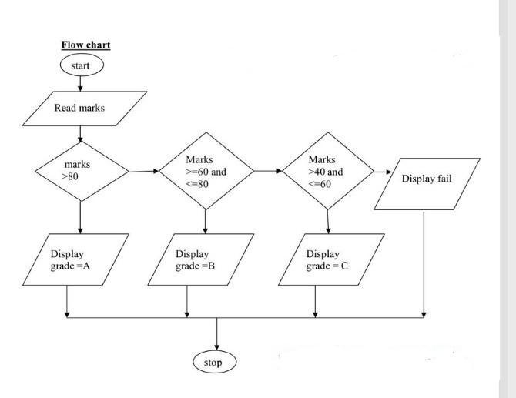
FLOW CHART

Slide 12
CODING
#include<stdio.h>
struct student
{
int rollno[100]; char name[100]; int m,s,ss,e,k,h;
};
struct student s[40];
intmain()
{
int size,i;
float total[40],percentage[40];
printf("Enter the number of students:");
scanf("%d",&size);
for(i=1;i<=size;i++)
{

Slide 13
printf("ENTER THE NAME OF THE STUDENT-%d::\n",i);
scanf("%s",s[i].name);
}
for(i=1;i<=size;i++)
{
printf("ENTER THE ROLL NO OF STUDENT %d:\n",i);
scanf("%d",&s[i].rollno);
}
for(i=1;i<=size;i++)
{
printf("ENTER THE MARKS OBTAINED IN ENGLISH BY STUDENT:%d\n",i);
scanf("%d",&s[i].e);
}
for(i=1;i<=size;i++)
{

Slide 14
printf("ENTER THE MARKS OBTAINED IN KANNADA BY STUDENT:%d\n",i);
scanf("%d",&s[i].k);
}
for(i=1;i<=size;i++)
{
printf("ENTER THE MARKS OBTAINED IN MATHS BY STUDENT:%d\n",i);
scanf("%d",&s[i].m);
}
for(i=1;i<=size;i++)
{
printf("ENTER THE MARKS OBTAINED IN SCIENCE BY STUDENT:%d\n",i);
scanf("%d",&s[i].s);
}
for(i=1;i<=size;i++)
{

Slide 15
printf("ENTER THE MARKS OBTAINED IN SOCIAL BY STUDENT:%d\n",i);
scanf("%d",&s[i].ss);
}
for(i=1;i<=size;i++)
{
printf("ENTER THE MARKS OBTAINED IN HINDI BY STUDENT:%d\n",i);
scanf("%d",&s[i].h);
}
for(i=1;i<=size;i++)
{
printf("\nNAME OF THE STUDENT -%d is %s",i,s[i].name);
}
for(i=1;i<=size;i++)
{

Slide 16
printf("\n STUDENT:%s\tROLL NO is :%d ",s[i].name,s[i].rollno);
}
printf("\n\n\n");
printf("----------- REPORT CARD -----------\n");
printf("\n\nSTUDENTS MARK SHEET\n");
printf("\n\n\n");
for(i=1;i<=size;i++)
{
printf("\n STUDENT:%s\t OBTIANED MARKS IN ENGLISH %d\n",s[i].name,s[i].e);
printf("\n STUDENT:%s\t OBTIANED MARKS IN KANNADA %d\n ",s[i].name,s[i].k);
printf("\n STUDENT:%s\t OBTIANED MARKS IN MATHS %d\n",s[i].name,s[i].m);
printf("\n STUDENT:%s\t OBTIANED MARKS IN SCIENCE %d\n",s[i].name,s[i].s);
printf("\n STUDENT:%s\t OBTIANED MARKS IN SOCIAL %d\n",s[i].name,s[i].ss);
printf("\n STUDENT:%s\t OBTIANED MARKS IN HINDI %d\n",s[i].name,s[i].h);
}

Slide 17
for(i=1;i<=size;i++)
{
total[i]=s[i].e+s[i].k+s[i].m+s[i].s+s[i].ss+s[i].s+s[i].h;
percentage[i] = total[i]/6;
printf("\n_ _ _ _ _ _ _ _ _ _ _ _ _ _ _ _ _ _ _ _\n");
}
for(i=1;i<=size;i++)
{
printf("\nThe total marks of %s is %.2f\n",s[i].name,total[i]);
printf("\n_ _ _ _ _ _ _ _ _ _ _ _ _ _ _ _ _ _ _ _\n");
printf("\nPercentage obtained by %s is %.2f\n",s[i].name,percentage[i]);
printf("\n_ _ _ _ _ _ _ _ _ _ _ _ _ _ _ _ _ _ _ _\n");
}
for(i=1;i<=size;i++)
if(percentage[i]>90)
{
printf("\n GRADE OBTAINED BY STUDENT:%s\tIS :A+\n",s[i].name);
}
else if(percentage[i]>80)
{

Slide 18
printf("\n GRADE OBTAINED BY STUDENT:%s\tIS :A\n",s[i].name);
}
else if(percentage[i]>70)
{
printf("\n GRADE OBTAINED BY STUDENT:%s\tIS :B+\n",s[i].name);
}
else if(percentage[i]>60)
{
printf("\n GRADE OBTAINED BY STUDENT:%s\tIS :B\n",s[i].name);
}
else if(percentage[i]>50)
{
printf("\n GRADE OBTAINED BY STUDENT:%s\tIS :C+\n",s[i].name);
}
else if(percentage[i]>35)
{
printf("\n GRADE OBTAINED BY STUDENT:%s\tIS :C\n",s[i].name);
}
else if(percentage[i]<35)
{
printf("\n THE STUDENT :%s IS FAILED\n",s[i].name);
}
}

Slide 19
TEST CASE ID | TESTING UNIT | TEST DATA | EXPECTED OUTPUT | TEST RESULTS | ACTION | DESCRIPTION
TID 1 | Entering the no of student | Total number of students, i.e 30 or 40 students in the class | It will take the data about the students | Data taken correctly | Accordingly, we can know the students reports. | This module will take the number of students as the input and the details of the students entered.
TID 2 | Entering the Students names and roll no of the student | Total number of students, i.e 30 or 40 Names and roll no’s students in the class | It will take the data about the Names and roll no’s of the students | Data taken correctly | Accordingly, we can know the students names and roll no’s | This module will take the number of students names and roll no’s as the input and the details of the students entered.
TID 3 | Enter the marks obtained by the students | Total number of subjects are 6 | It will take the data about the Subjects Written by the students | Data taken correctly | Accordingly, we can know the students marks obtained in the subjects | This module will take data about the Subjects Written by the students as input and the details of the students entered.

Slide 20
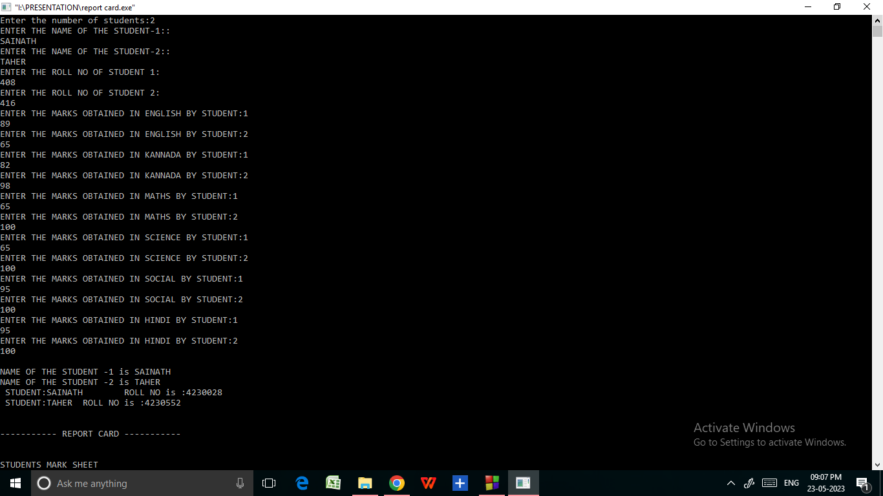
OUTPUT

Slide 21
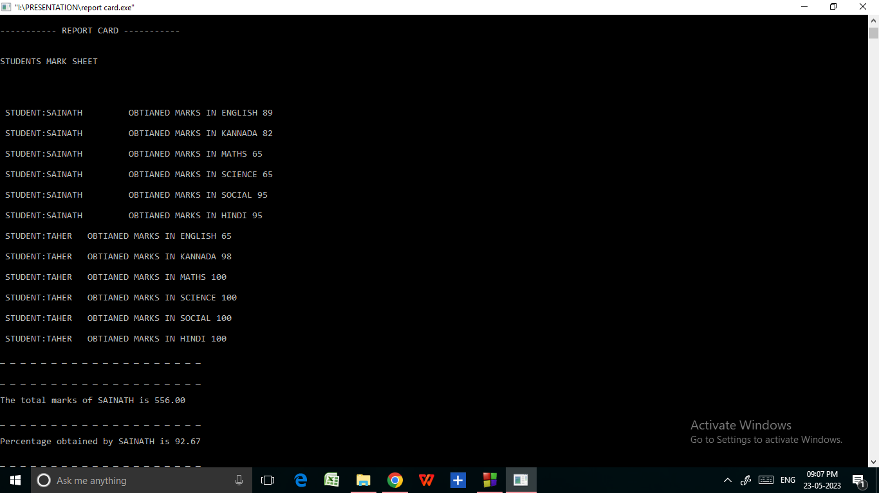

Slide 23
CONCLUSION
In conclusion, the student report card serves as a valuable tool for assessing a student's academic performance. By analyzing the grades and overall performance, it becomes possible to identify areas of strength and areas that require improvement.
The report card provides an overview of the student's achievements in various subjects, highlighting their proficiency and understanding. It also serves as a basis for identifying trends and progress over time. By comparing the grades with benchmarks or class averages, it is possible to gauge the student's performance relative to their peers.
Teacher comments and feedback on the report card can offer valuable insights into the student's learning abilities, study habits, behavior, and areas that require attention. These comments can guide further actions, such as providing additional support or creating tailored study plans.
Overall, the student report card is a crucial tool for evaluating a student's academic journey, providing feedback, and facilitating discussions between teachers, students, and parents to support the student's growth and development.

